Slide 1
Ohua-Powered, Semi-Transparent UDF’s in the Noria Database
By Justus Adam
Supervisor: Sebastian Ertel, Dirk Habich, Malte Schwarzkopf and Jerónimo Castrillón-Mazo

Slide 2
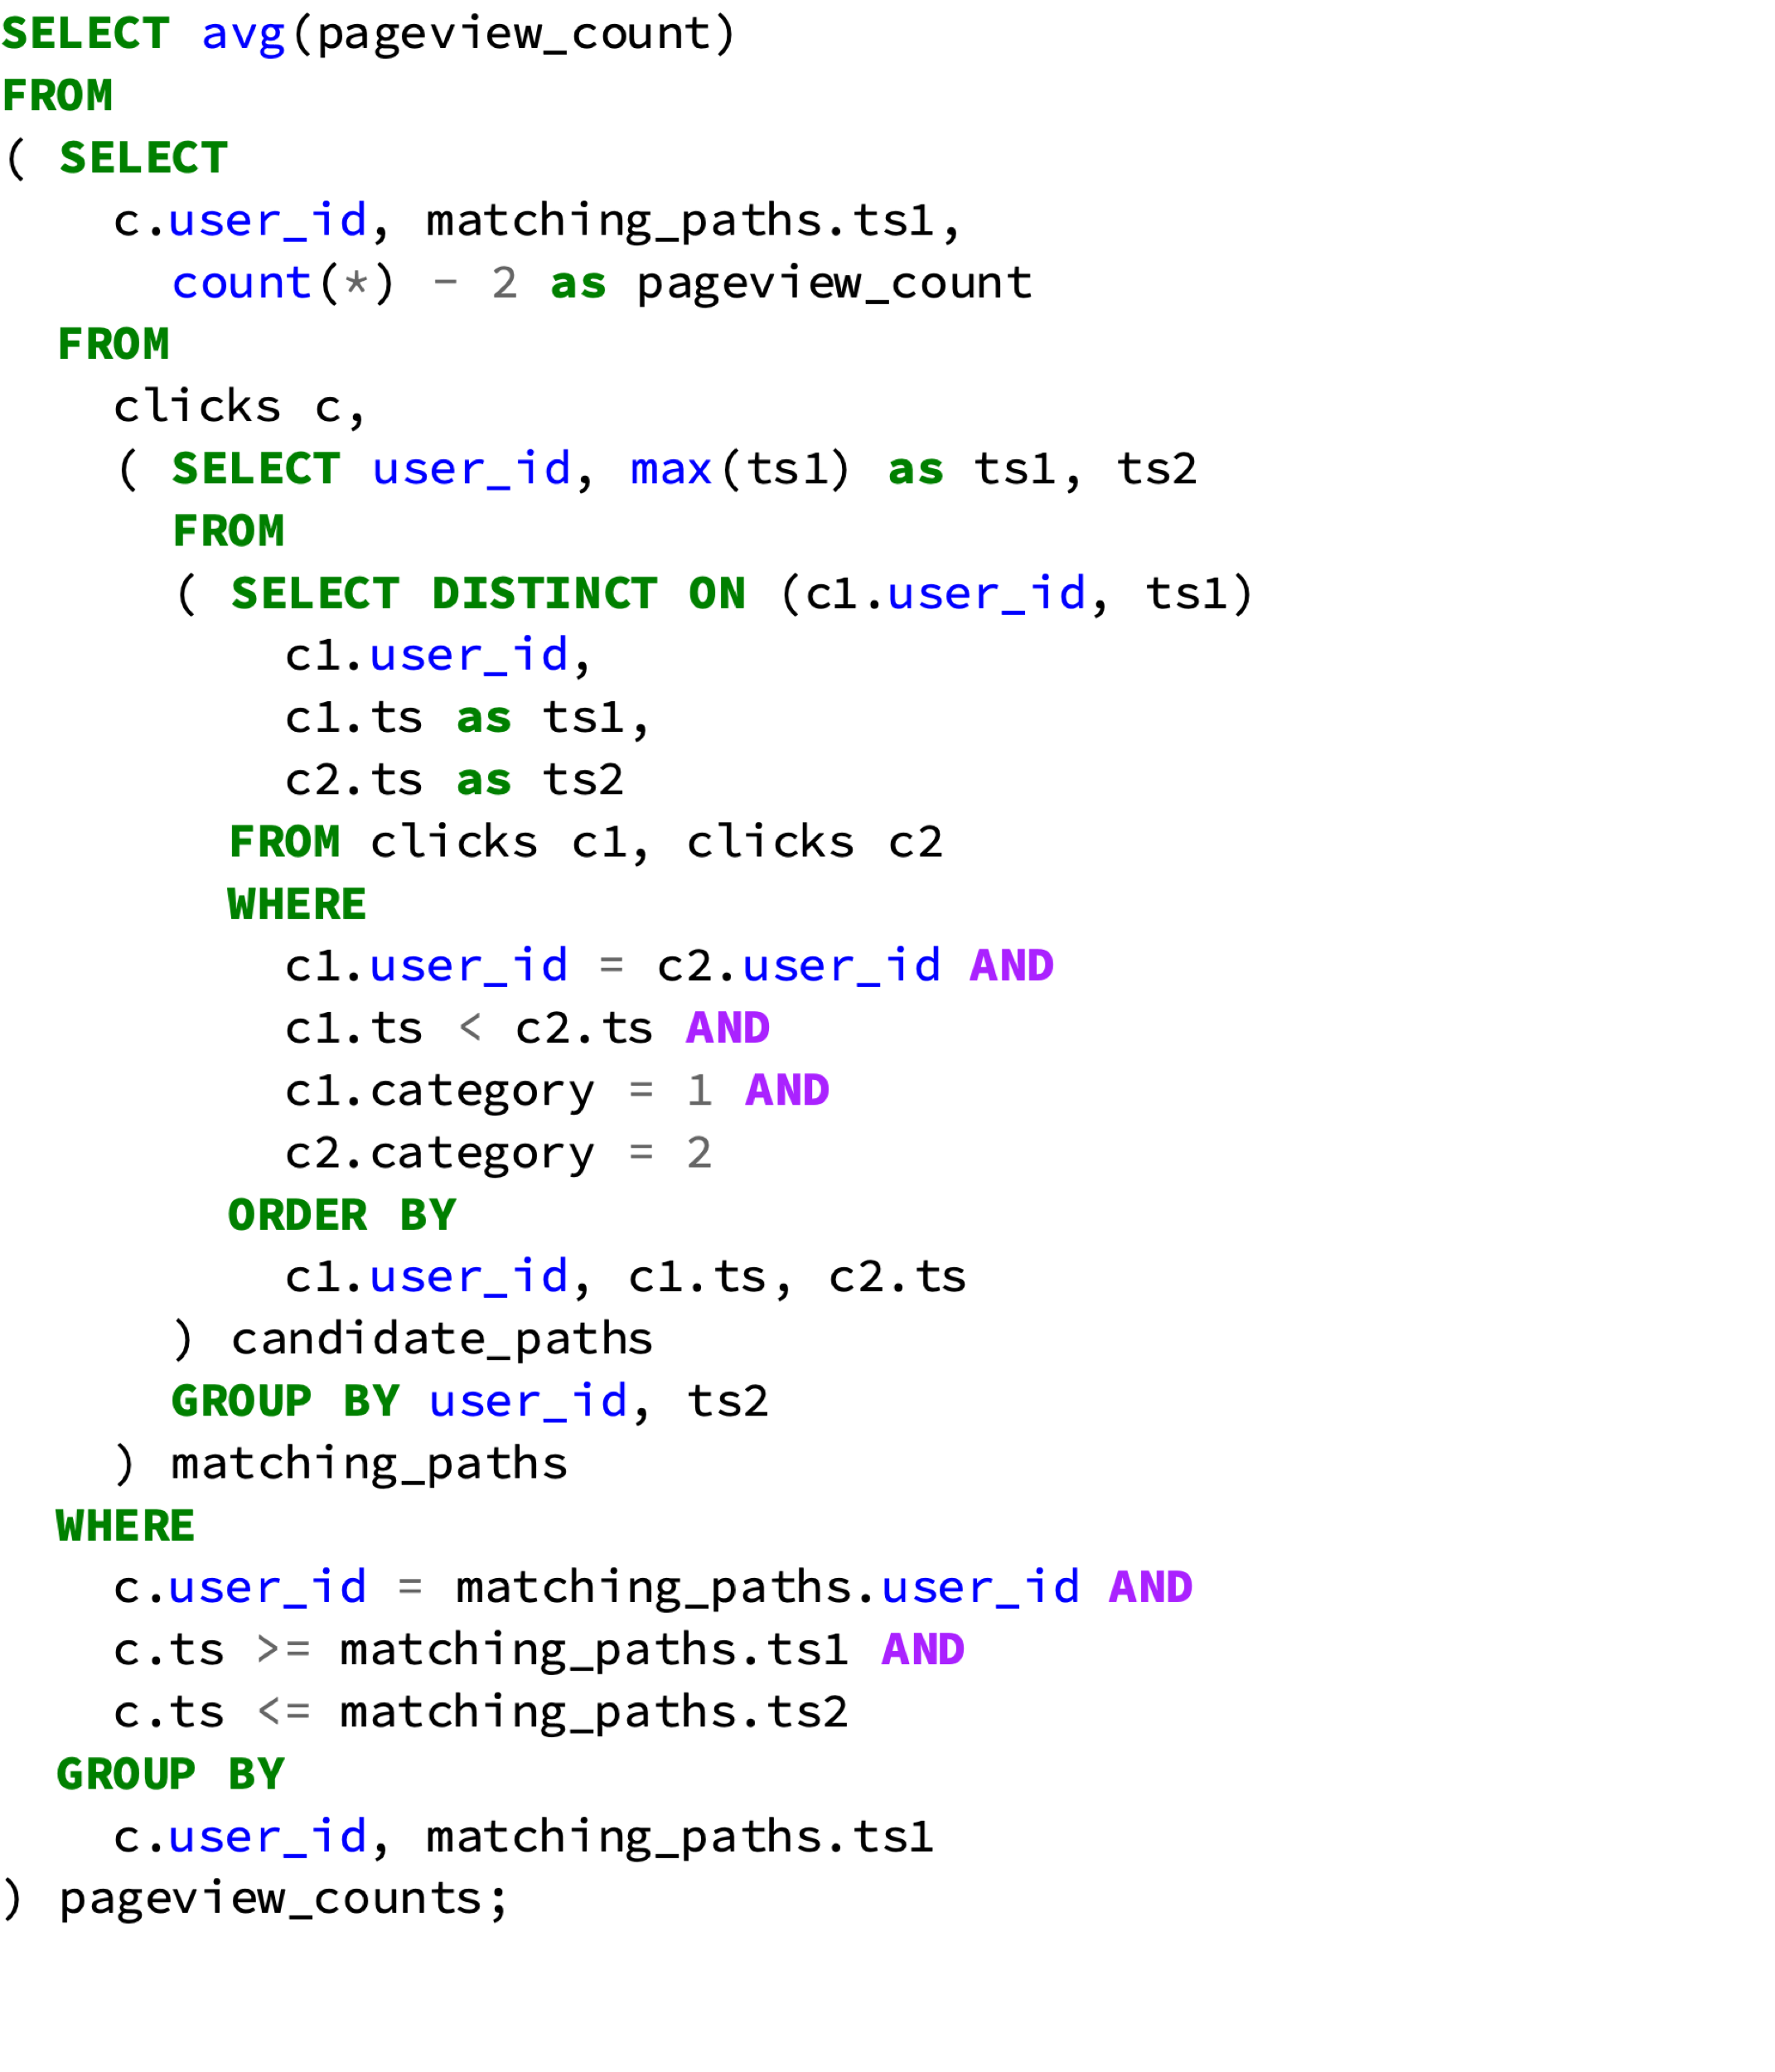
A query to start with
5. Average of the count, per user
Query: How many clicks, on average, does it take for a user to get from the start page to a purchase
1. The table, but more than once
3. Only the non-overlapping ones
Table layout
2. Delimiters for an ordered sequence, if user is the same
uid | Category | Timestamp
1 | 1 | 001
1 | 0 | 005
1 | 2 | 010
4. The actual clicks in between the sequence, if user is the same
Eric Friedman, Peter Pawlowski, and John Cieslewicz. 2009. SQL/MapReduce: a practical approach to self-describing, polymorphic, and parallelizable user-defined functions. Proc. VLDB Endow. 2, 2 (August 2009), 1402-1413.

Slide 3
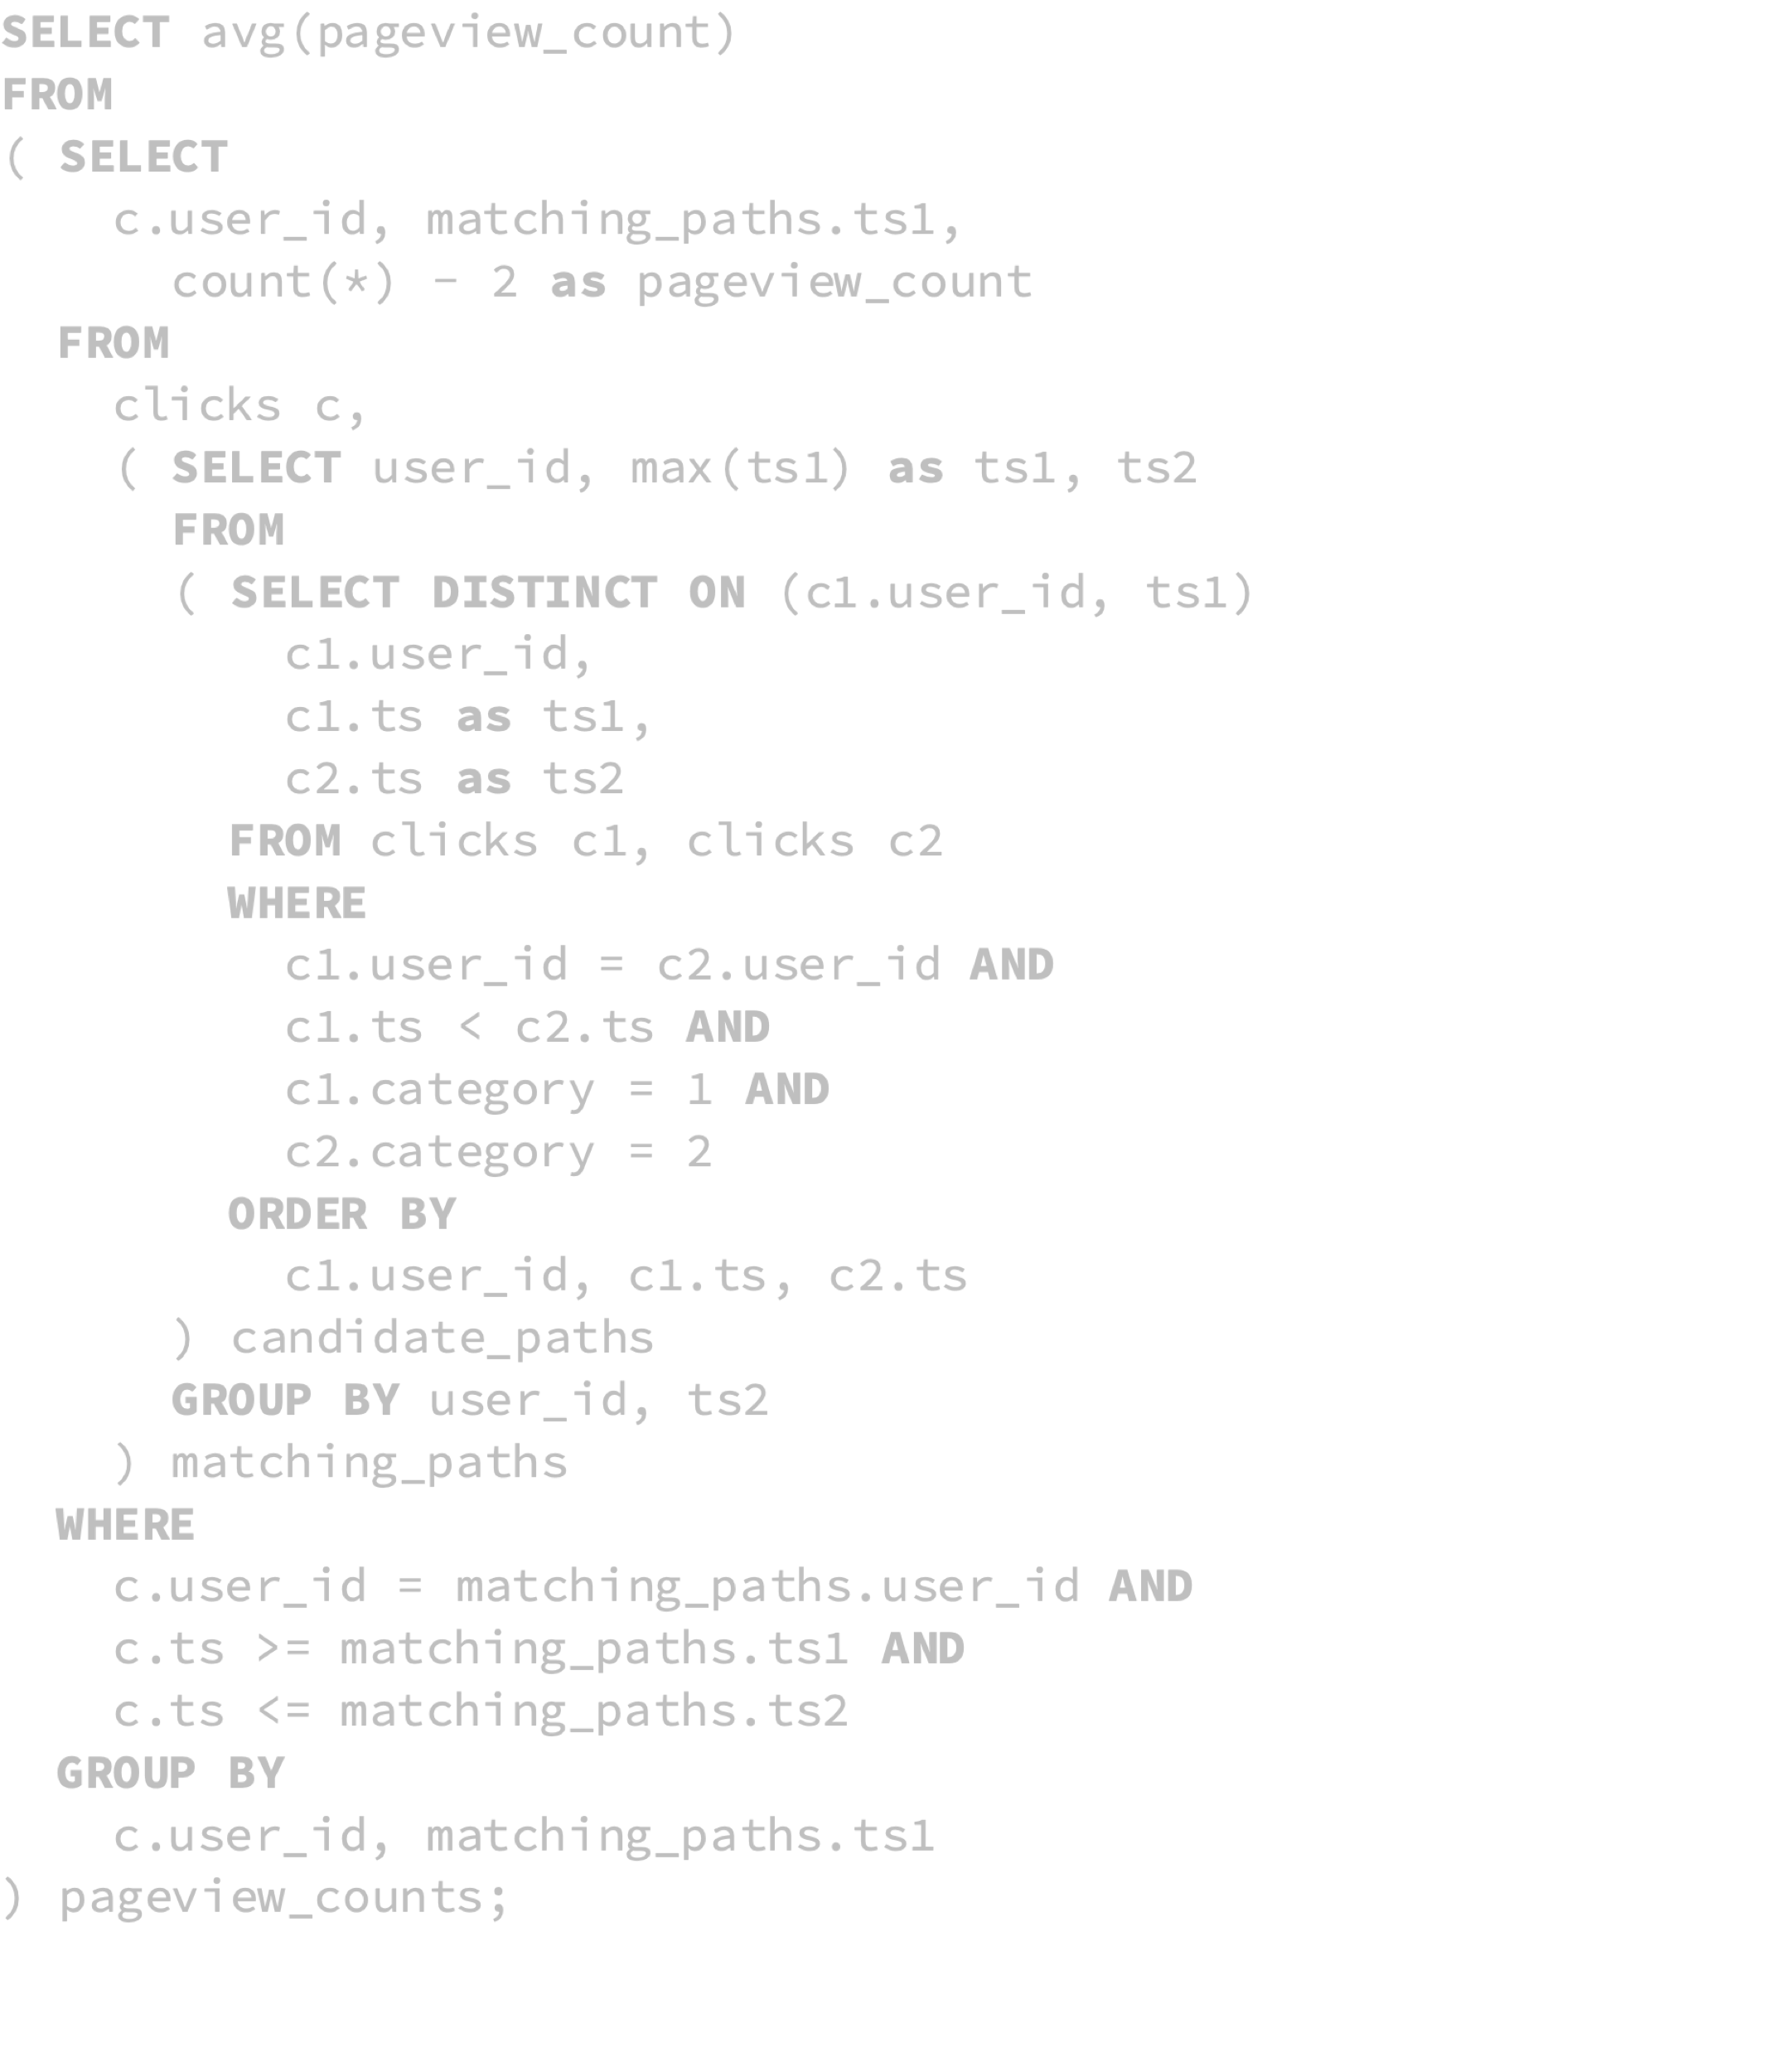
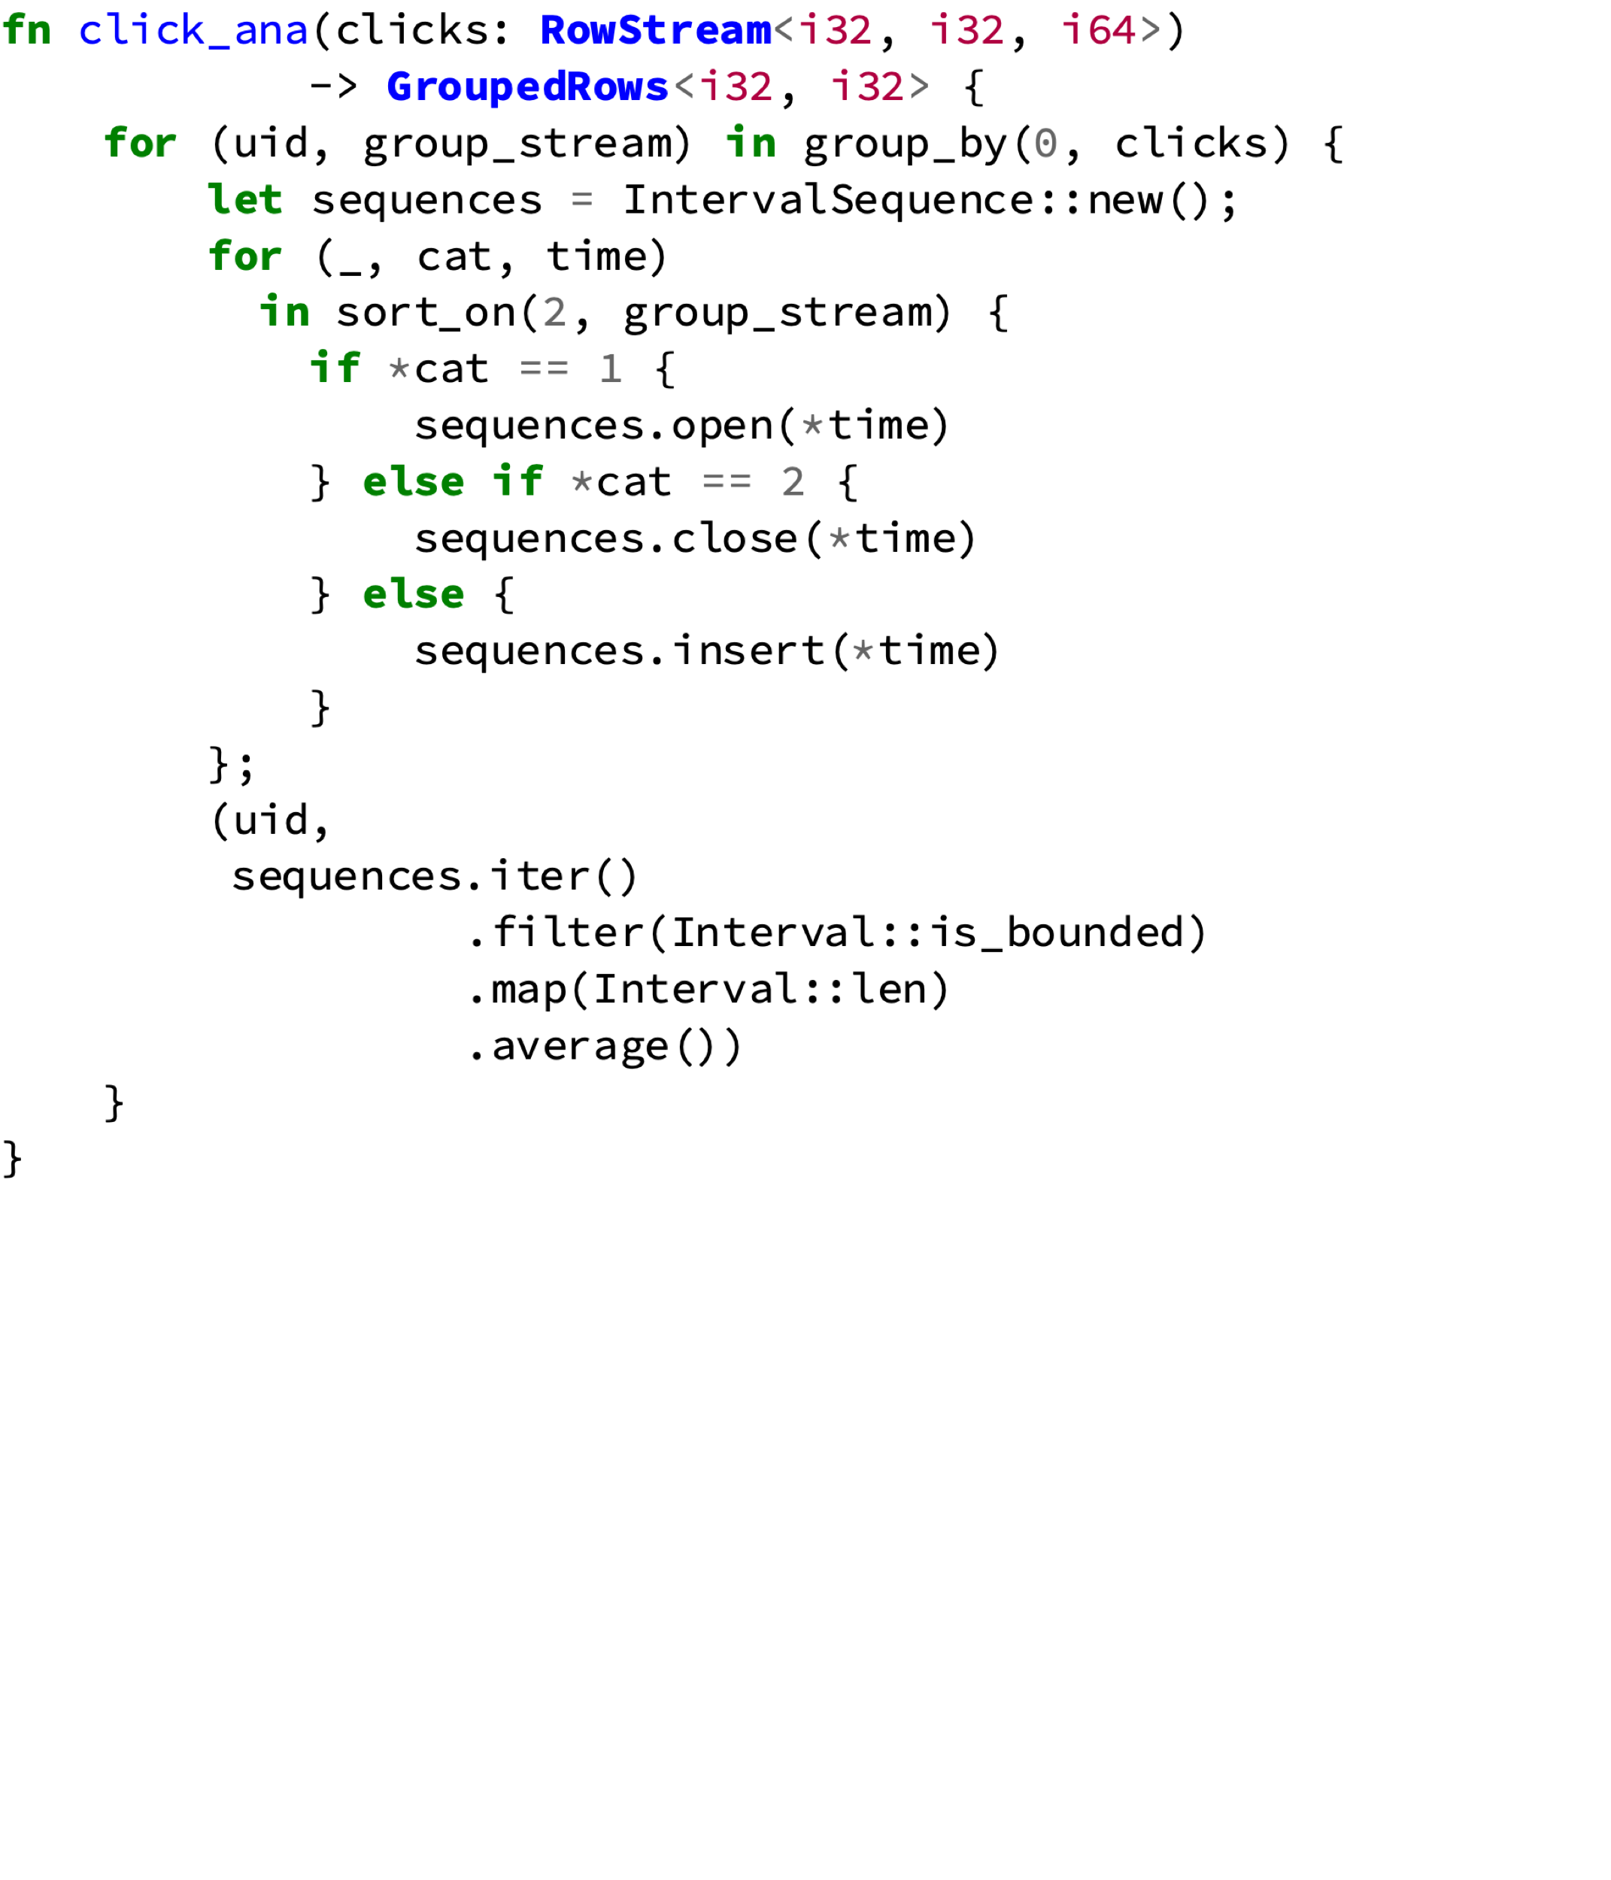
Coding it up
Query: How many clicks, on average, does it take for a user to get from the start page to a purchase
Easier^{[1,2]}:
1. Per user
2. In sorted order
Table layout
3. Begin/end sequence or count event
uid | Category | Timestamp
1 | 1 | 001
1 | 0 | 005
1 | 2 | 010
4. Average for length of closed intervals
Rakesh Agrawal et al. 2008. The Claremont Report on Database Research. In: SIGMOD Rec. 37.3, 9–19.
Charles Welty and David W. Stemple. 1981. Human Factors Comparison of a Procedural and a Nonprocedural Query Language. In: ACM Trans. Database Syst. 626– 649

Slide 4
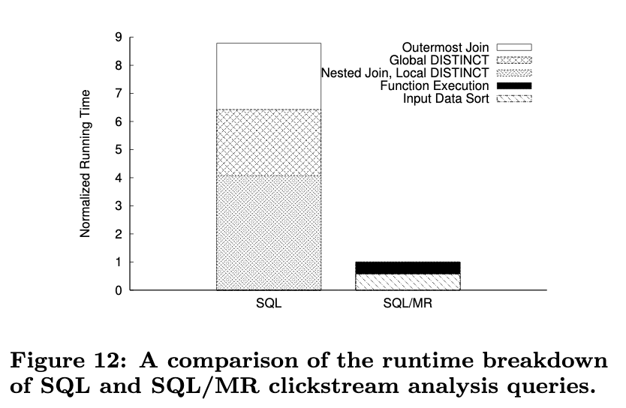
Coding it up
Query: How many clicks, on average, does it take for a user to get from the start page to a purchase
Easier:
Imperative is more efficient because of the many joins in SQL
Table layout
uid | Category | Timestamp
1 | 1 | 001
1 | 0 | 005
1 | 2 | 010
Eric Friedman, Peter Pawlowski, and John Cieslewicz. 2009. SQL/MapReduce: a practical approach to self-describing, polymorphic, and parallelizable user-defined functions. Proc. VLDB Endow. 2, 2 (August 2009), 1402-1413.

Slide 5
Coding it up
Query: How many clicks, on average, does it take for a user to get from the start page to a purchase
Easier:
Dataflow!
Noria^{[2]}
Dataflow system. Uses materialization (state) to improve read performance
Ohua^{[1]}
Parallelizable language with a stateful dataflow backend
Table layout
uid | Category | Timestamp
1 | 1 | 001
1 | 0 | 005
1 | 2 | 010
Sebastian Ertel, Christof Fetzer, and Pascal Felber. Ohua: Implicit Dataflow Programming for Concurrent Systems. 2015. PPPJ ’15. 51–64
Jon Gjengset et al. 2018. Noria: dynamic, partially-stateful data-flow for high-performance web applications. In Proceedings of the 12th USENIX conference on Operating Systems Design and Implementation (OSDI'18). USENIX Association, Berkeley, CA, USA, 213-231.

Slide 6




Noria
Multicore
Distributed
No UDF Support
Long write path (slow)
Short read path (fast)
Base table
Cached computations (Incremental Materialization)
Simple Materialization recomputes everything on change
Incremental Materialization only recomputes affected rows. Operators must work with changes (Deltas)
Update propagation (eventual consistency)
Notes:
Dataflow system
Materialized View
Partial State
Fast reads
For Websites
Has no UDF support (yet)

Slide 7
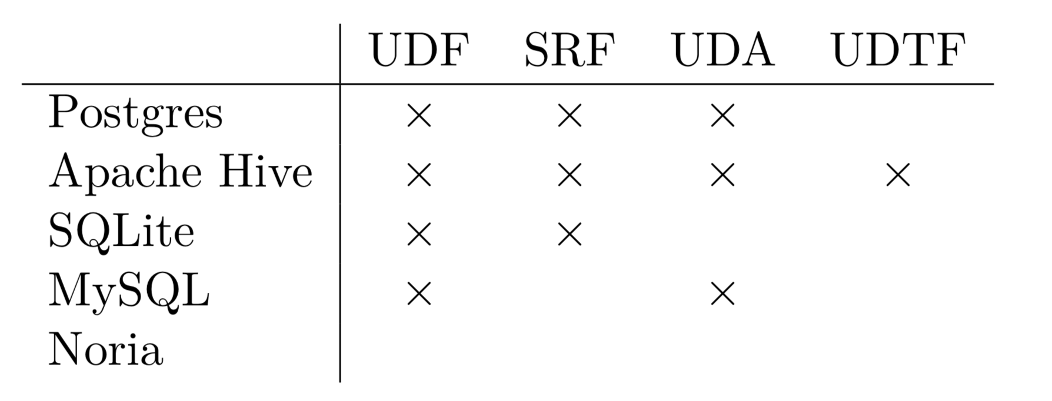
Hierarchy of UDF’s
Limits Expressiveness
Expressiveness
Optimization
1
1
ST-UDF
n
1
1
n
UDA
SRF
Hinders analysis and optimization
n
m
UDTF
Partial order: Any UDA can be expressed as a UDTF but not vice versa
Our target
UDF support in different Databases

Slide 8
Hierarchy of UDF’s
Challenges
Expressiveness
Optimization
1
1
ST-UDF
Incrementalizing
n
1
1
n
Incrementalizing
State management
UDA
SRF
Difficult, but we already know how to do it for ST-UDF/UDA
UDF generation
Control Flow representation
n
m
Incrementalizing
State management
Optimization
UDTF
Graph Fragment
No good, general solution yet, but solved for ST-UDF/UDA
UDA
💡 Relate back to ST-UDF/UDA 💡
π
⋈
ST-UDF

Slide 9
Roadmap
State Management
Operator Generation
Incremental Computation
Control Flow Representation
?
ST-UDF and UDA
UDTF

Slide 10
Roadmap
Work in incremental materialized view
State Management
Operator Generation
Incremental Computation
Control Flow Representation
?
ST-UDF and UDA
UDTF

Slide 11
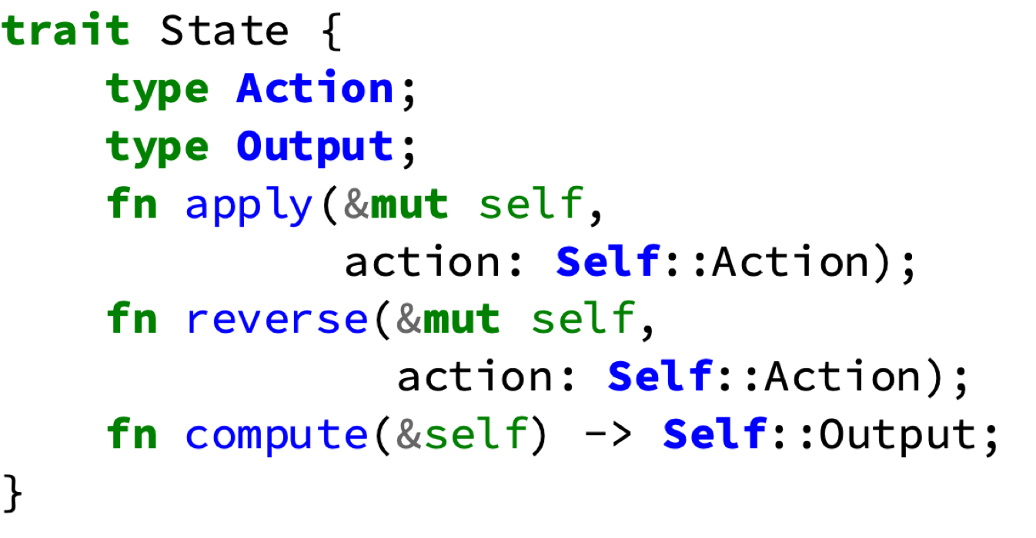
Incremental computation
Simple Mat.
Complete Recompute
Easy to build
Inefficient
Incremental Mat.
Changes recompute
Efficient
Difficult to build
Represented with inserts and deletes
Operators must recompute all affected previous results (requires tracking state) and issue updates downstream.
Only state needs to be incremental
ST-UDF
Relatively easy, propagate whether input was update or delete to the output.
(Same for SRF)
UDA
Only one, known affected previous result
State determines new value
Must reverse changes to state

Slide 12
Roadmap
Work in incremental materialized view
Selection by index
Eviction
Sharding
State Management
Operator Generation
Incremental Computation
Control Flow Representation
?
ST-UDF and UDA
UDTF

Slide 13

UDA State Management
Materialization
Customizable Addition
Determined from query (primary key, group-by etc)
uid | Category | Timestamp
1 | start | 1
1 | other | 5
1 | end | 10
UDA State
Index
UDA
uid:1
uid:2
uid:3
uid | Category | Timestamp
2 | start | 2
2 | end | 55
2 | other | 8
Cached results
$$∅$$
Evicted Entry
Notes:
Evicted upstream means evicted downstream

Slide 14
UDA State Management
Materialization
Customizable Addition
uid | Category | Timestamp
1 | start | 1
1 | other | 5
1 | end | 10
UDA State
Index
Available for processing via lookup
UDA
uid:1
uid:2
uid:3
uid | Category | Timestamp
2 | start | 2
2 | end | 55
2 | other | 8
$$∅$$
Can evict UDA state to save memory
Sharding distributes data over index
Reusing index allows UDA’s to support sharding

Slide 15
Roadmap
Work in incremental materialized view
Selection by index
Eviction
Sharding
Find suitable operators
Handle shared state
Generate boilerplate
State Management
Operator Generation
Incremental Computation
Control Flow Representation
?
ST-UDF and UDA
UDTF

Slide 16
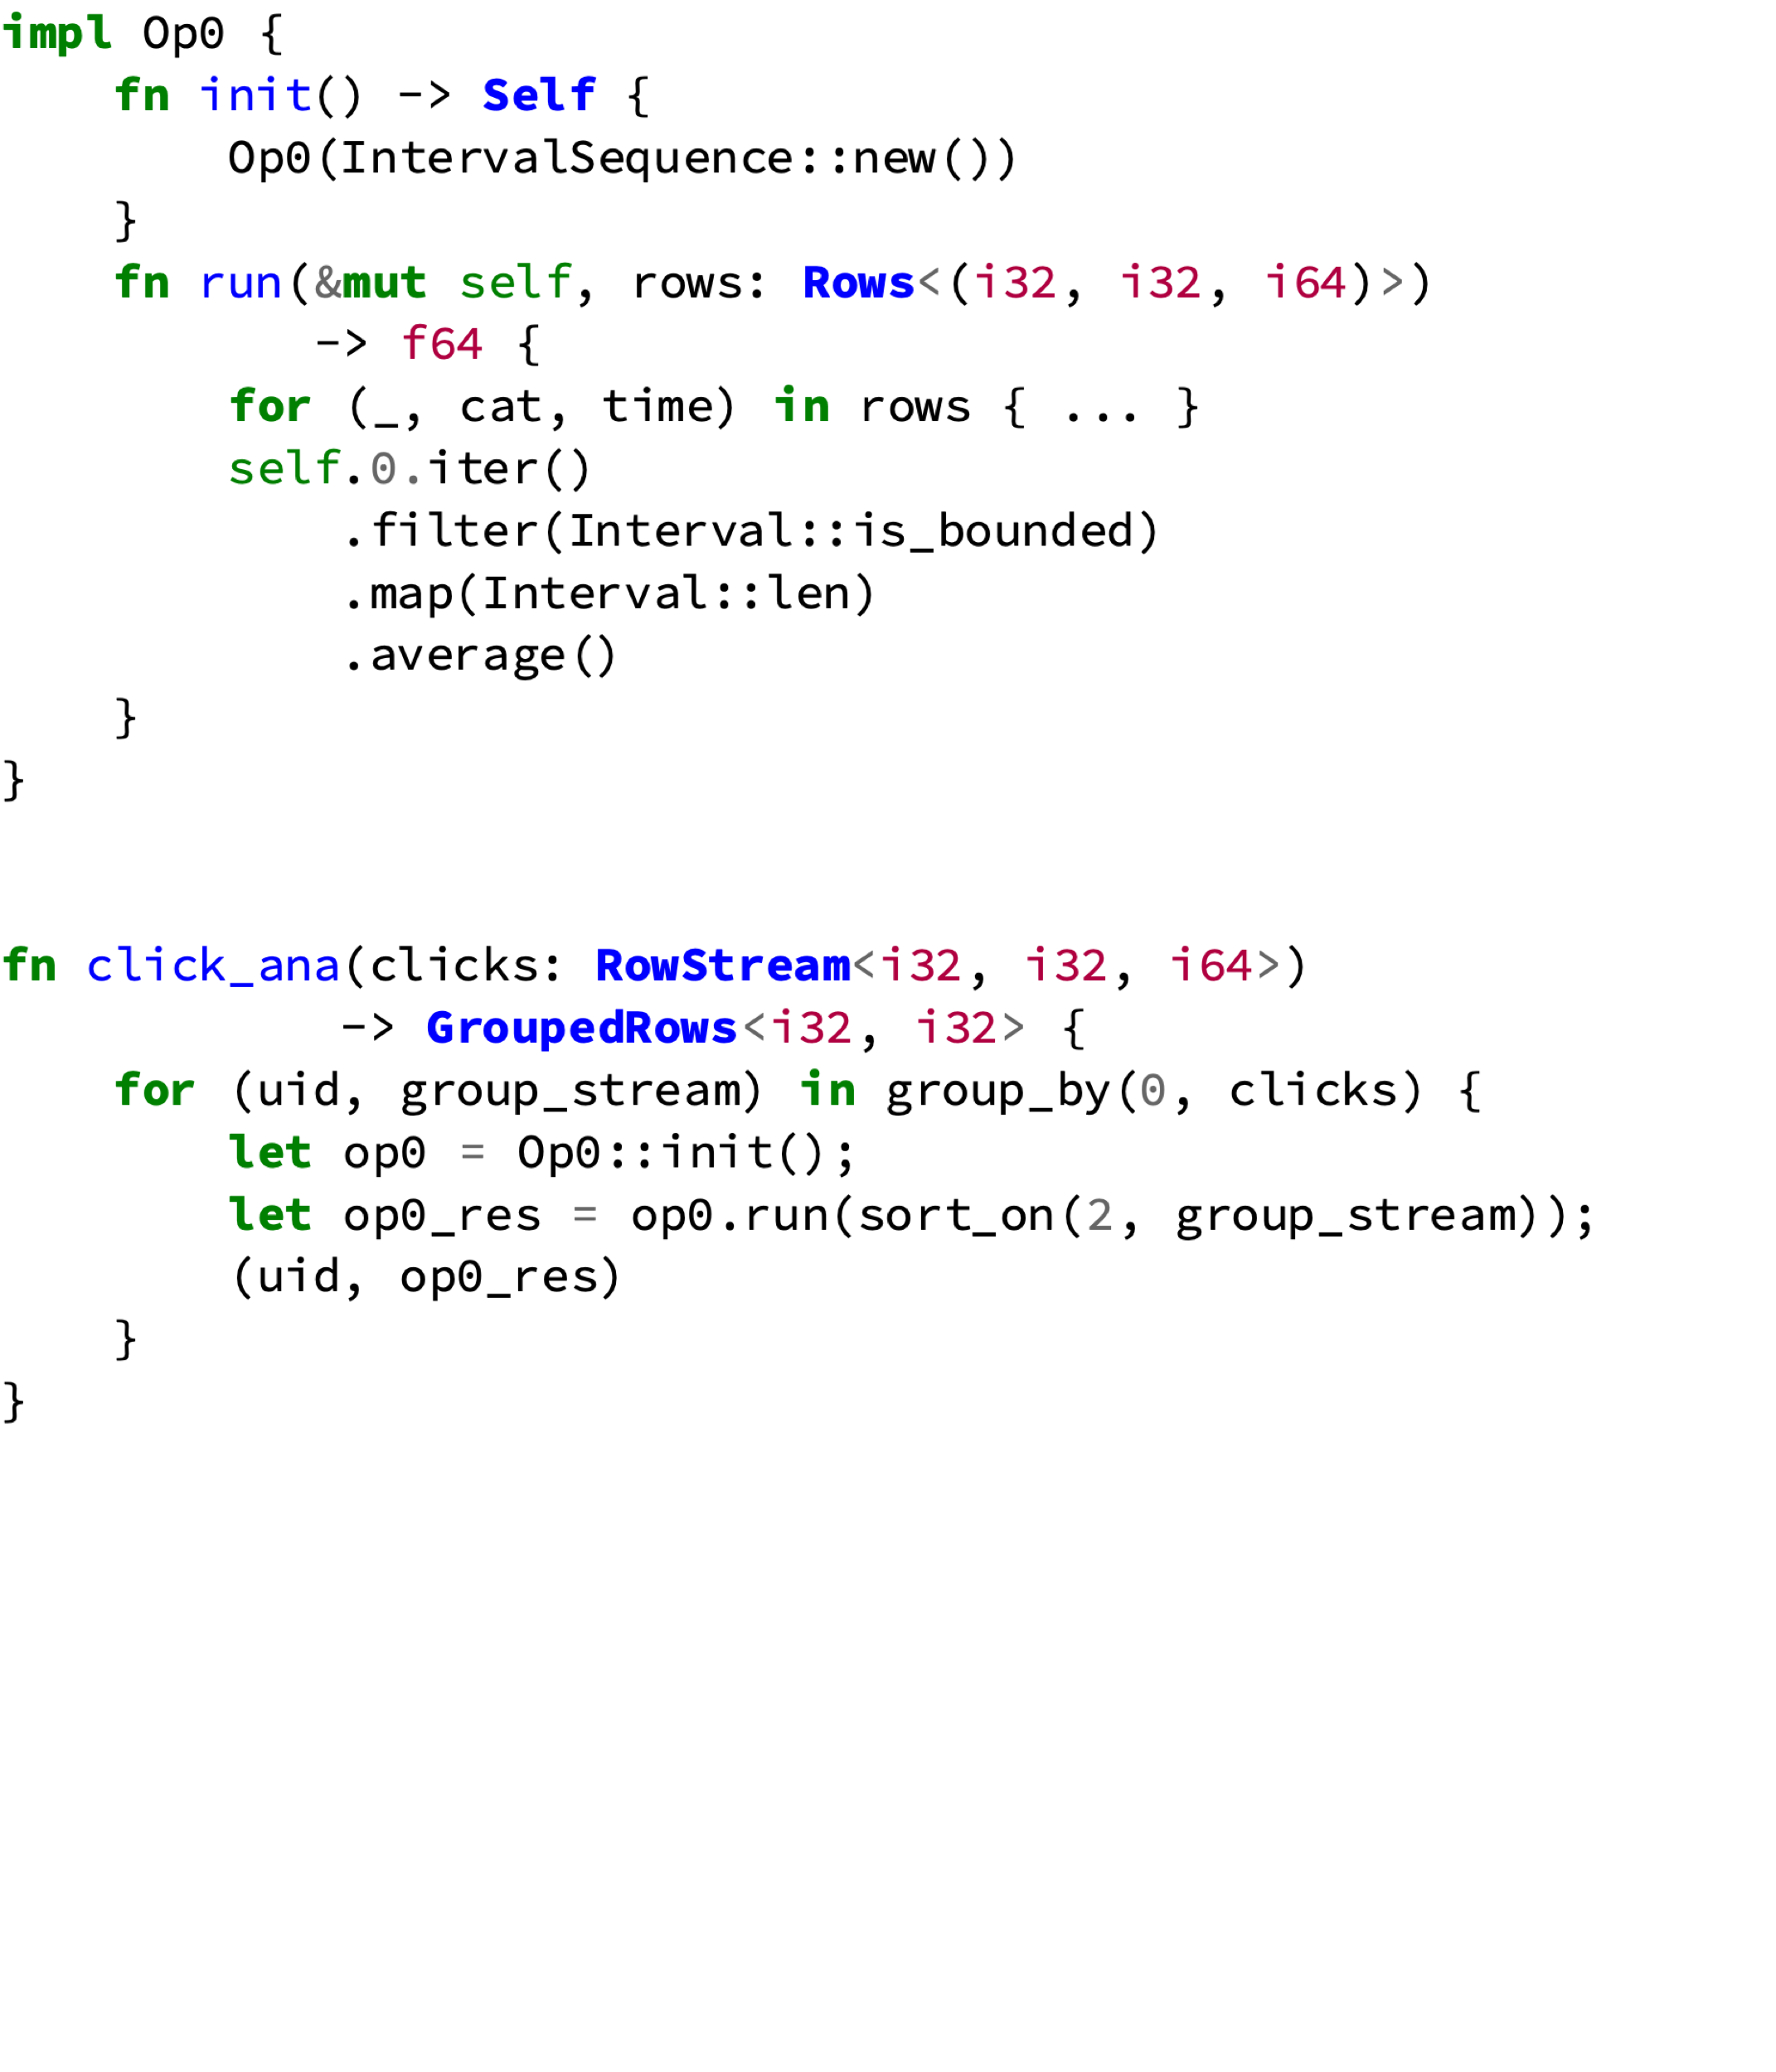
Operator Generation
Shared state means synchronization
Complicates or prevents parallelism
Not supported in Noria
💡 Make minimal operator with local state
5. Add boilerplate appropriate for type of generated UDF (not shown)
Only operator local state left
Operator Core (Rust)
1. Select init expression
4. Bundle into operator
2. Select all state uses
3. Recursively select dependencies
UDTF (Ohua)
Rest of program

Slide 17
Roadmap
Work in incremental materialized view
Selection by index
Eviction
Sharding
Find suitable operators
Handle shared state
Generate boilerplate
Representation as query
State scoping
Multi-arity functions
State Management
Operator Generation
Incremental Computation
Control Flow Representation
?
ST-UDF and UDA
UDTF

Slide 18
Iteration Representation
Operators always work on batches for efficiency
No special iteration operator needed
State must respect scope
State value only valid for one iteration
Sequence never created
Source streams items
Each row tagged with index
Number of iterations not known. Incremental execution revisits state.
→ Cannot just duplicate operator
→ State index & dispatch needed
Sequence source provides index
Found by analysing control flow context
Index
GROUP BY
UDA State already indexed
12. Slide
Nesting achieved via compound indices
UDA
uid:1
uid:2
uid:3
Cache + UDA State

Slide 19
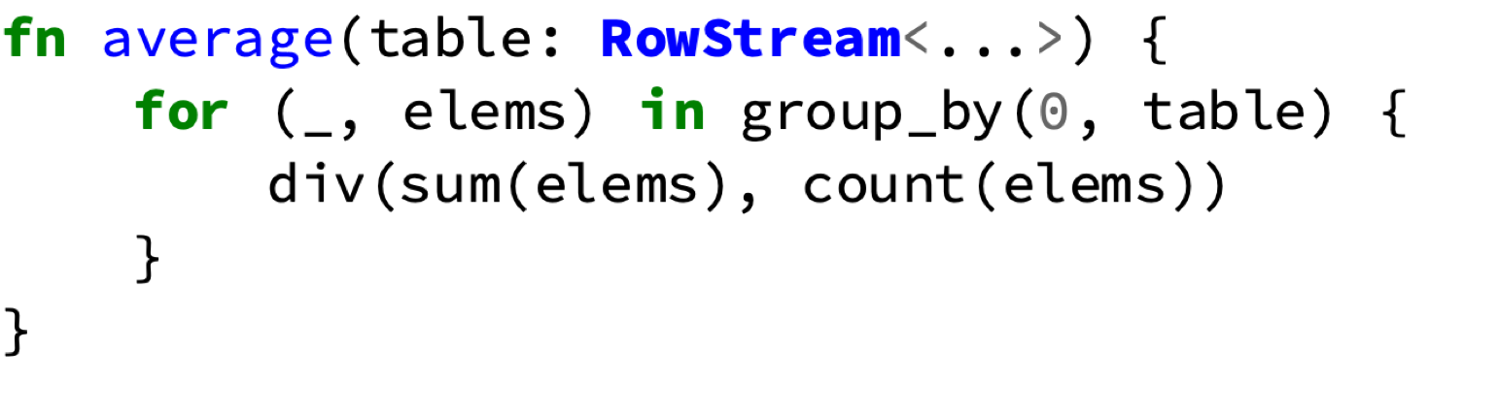
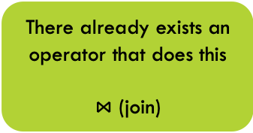
Multi argument functions
Scope key from before also associates iterations
There already exists an operator that does this
$⋈$ (join)
GROUP BY
Order of output tuples cannot be guaranteed
Only interesting for multiple outputs i.e. iteration
Needs an key to join iterations on
Needs to line up inputs from same iteration
All inputs packaged up nicely in single row
Also works correctly for variables from outside the for-loop

Slide 20
Roadmap
Work in incremental materialized view
Selection by index
Eviction
Sharding
Find suitable operators
Handle shared state
Generate boilerplate
Representation as query
State scoping
Multi-arity functions
State Management
Operator Generation
Incremental Computation
Control Flow Representation
?
ST-UDF and UDA
UDTF
Evaluation
Interoperability with SQL
Composition/Control Flow
Optimization (Parallelization)

Slide 21
Evaluation – Overhead & Expressiveness
Multi-argument functions and inner-joins naturally correspond
Performance difference in query due to extra operators inserted by compiler
Separate performance comparison of generated sum and SQL sum operators shows no difference
Performance of Ohua-compiled average query in comparison to SQL

Slide 22
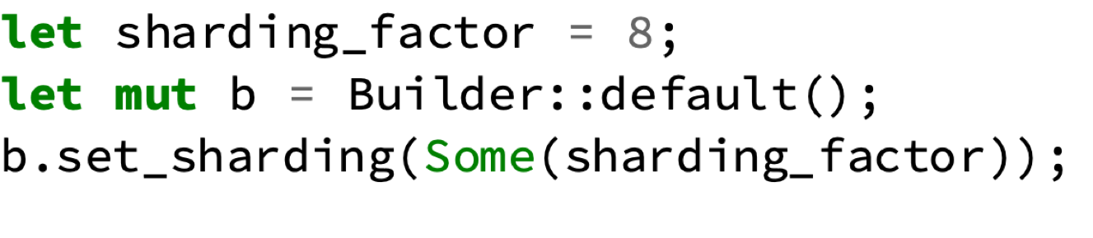
Evaluation - Parallelism
0..3
4..7
8..11
Data sharded by range of hashes of index values
run
op0
run
op0
run
op0
Operator state split into distinct pieces
Iteration local state allows splitting
Leveraging the parallelism is simply setting a runtime parameter
Parallel processing possible without explicit parallel contructs
Throughput of clickstream analysis with increasing sharding factor

Slide 23
Roadmap
Work in incremental materialized view
Selection by index
Eviction
Sharding
Find suitable operators
Handle shared state
Generate boilerplate
Representation as query
State scoping
Multi-arity functions
State Management
Operator Generation
Incremental Computation
Control Flow Representation
Imperative Query
ST-UDF and UDA
UDTF
Imperative-only query
Embedding SQL in procedural
Recursion
Evaluation
Interoperability with SQL
Composition/Control Flow
Optimization (Parallelization)

Slide 24
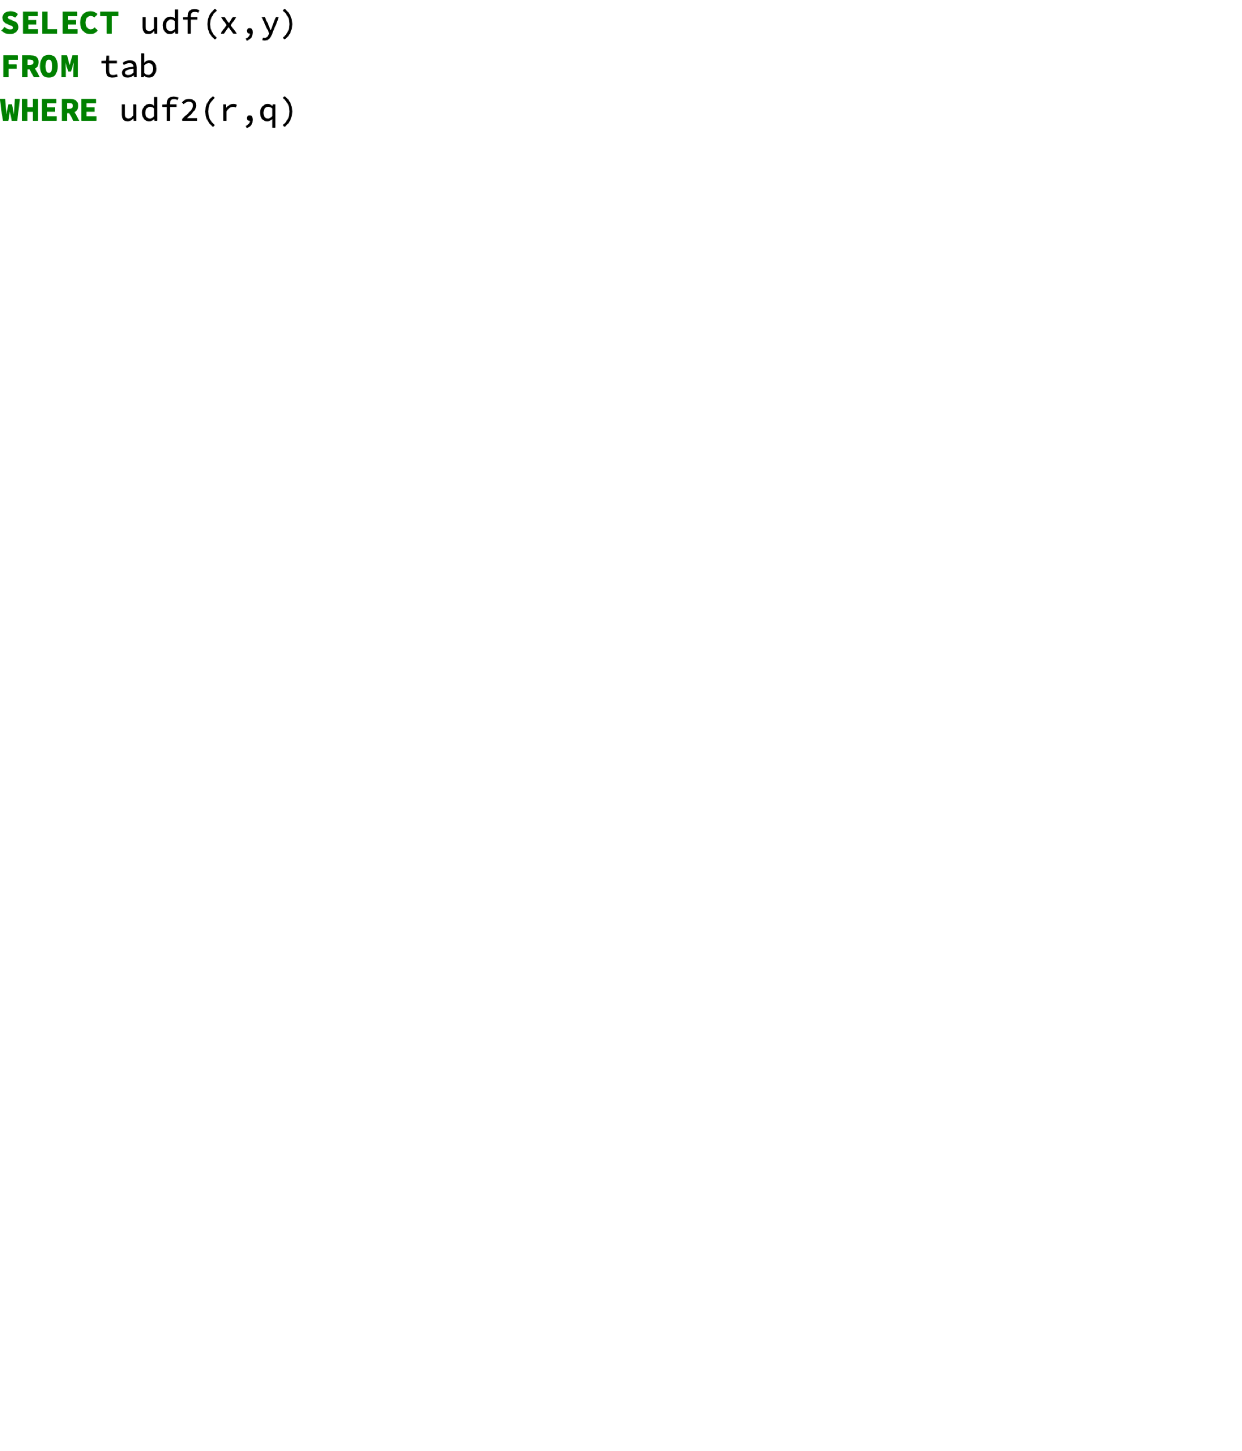
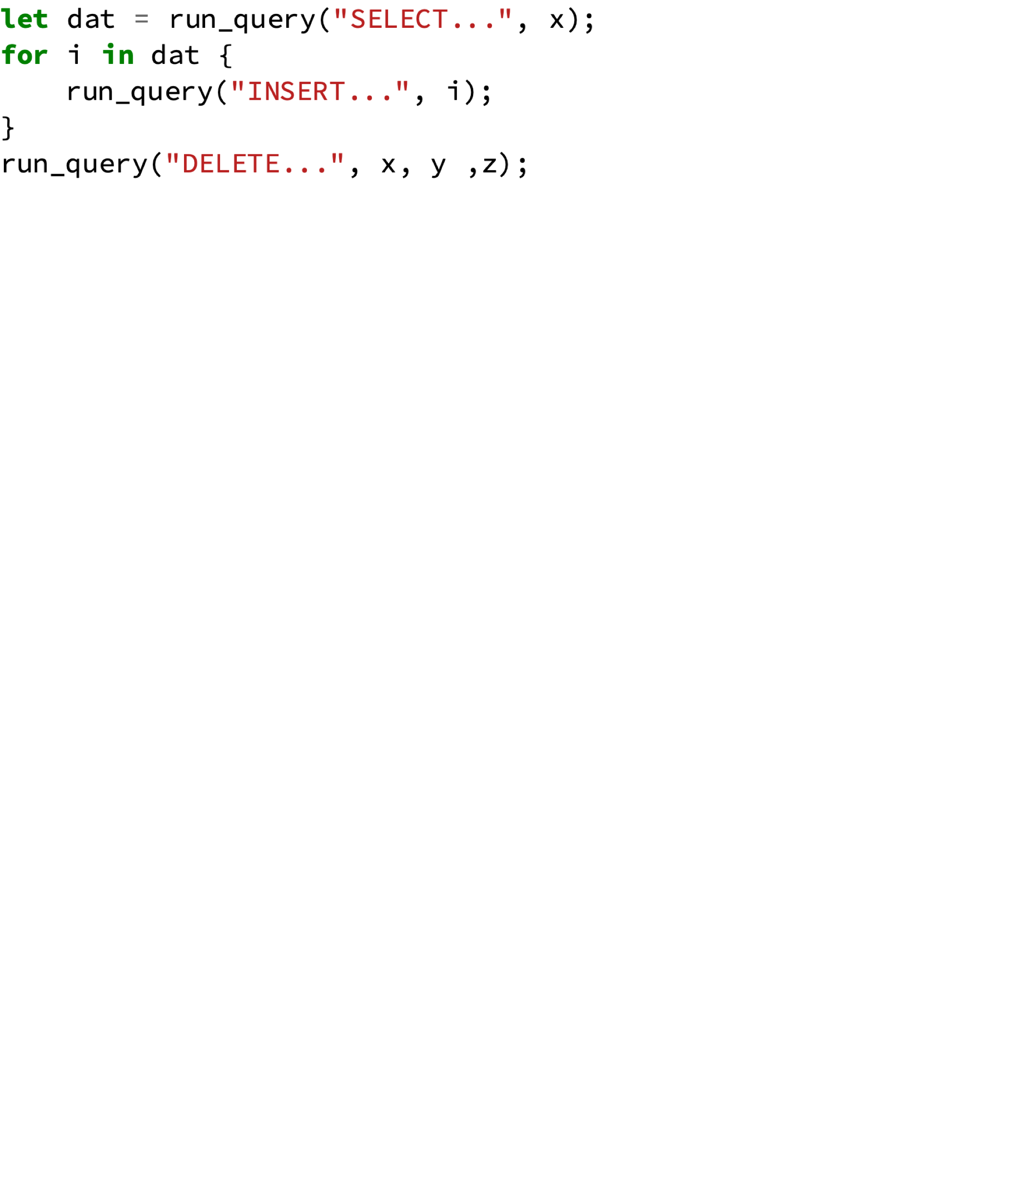
Outlook – Embedding SQL
With common dataflow base we can also embed SQL in imperative program
Initial goal: Embedding Imperative in SQL
SQL
Imperative
Created query dataflow representation for procedural programs
SQL compiles to dataflow
Dataflow
SQL involvement not necessary: Procedural-only query is possible
With Ohua, dataflow becomes common base

Slide 25
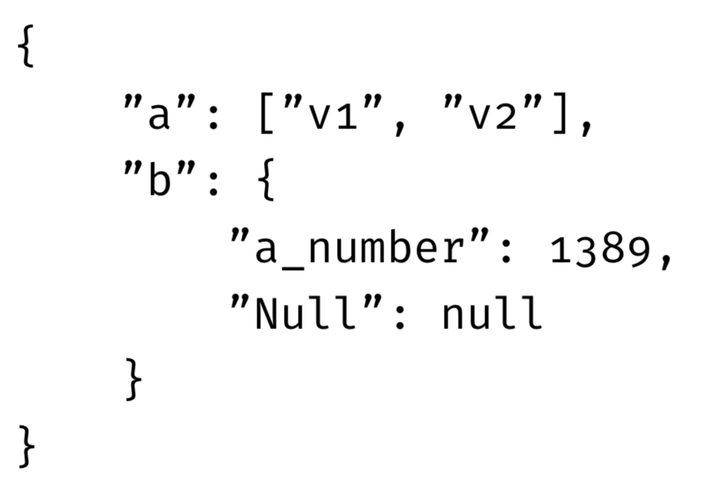
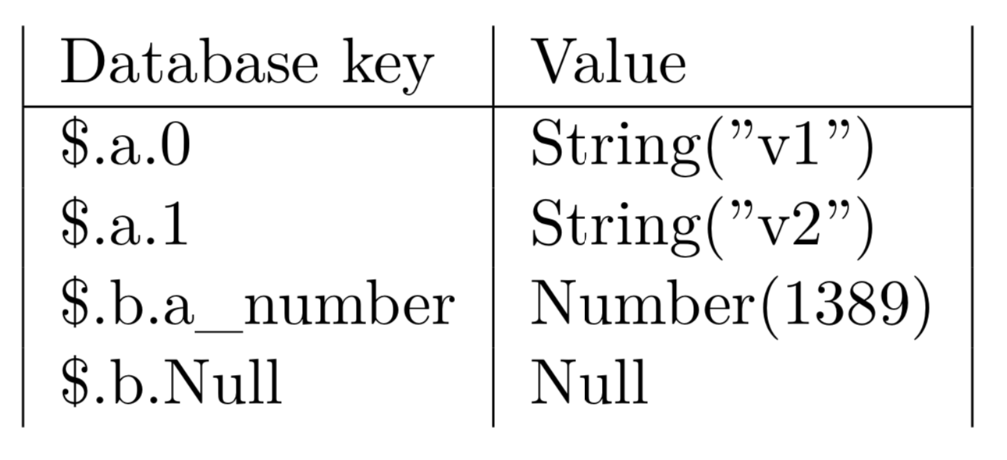
Outlook - Recursion
Arbitrary nesting needs recursive decoding of inner structure
Materialization builds a map of resolved object keys ^{[1]}
Splitable, binary JSON
Recursive self-call
decode
Zhen Hua Liu et al. Closing the Functional and Performance Gap Between SQL and NoSQL. 2016. SIGMOD ’16. 227–238.

Slide 26
Roadmap
Work in incremental materialized view
Selection by index
Eviction
Sharding
Find suitable operators
Handle shared state
Generate boilerplate
Representation as query
State scoping
Multi-arity functions
State Management
Operator Generation
Incremental Computation
Control Flow Representation
Imperative Query
ST-UDF and UDA
UDTF
Imperative-only query
Embedding SQL in procedural
Recursion
Evaluation
Interoperability with SQL
Composition/Control Flow
Optimization (Parallelization)

Slide 27
Simple Materialization
Materialization
Data Transferred
Entire Table transferred and processed. Inefficient and with high latency
uid | Category | Timestamp
1 | start | 1
1 | other | 5
1 | end | 10
1 | other | 11
Base Table
inserted
deleted
uid | Category | Timestamp
1 | start | 1
1 | other | 5
1 | end | 10
UDF
Does no processing, hence same materialization as upstream
uid | Click Distance
1 | 2
uid | Click Distance
1 | 2
Fast reads by serving from lookup table (materialization)

Slide 28
Incremental Materialization
Materialization
Data Transferred
uid | Category | Timestamp
1 | start | 1
1 | other | 5
1 | end | 10
1 | other | 11
Base Table
Sign added to each row
Only deltas transferred and processed
sign | uid | Category | Timestamp
+ | 1 | other | 5
- | 1 | other | 11
Private materialization as lookup table for downstream operators
UDF
uid | Click Distance
1 | 2
Operator must be able to adjust the result on delete
sign | uid | Click Distance
- | 1 | 1
+ | 1 | 2
uid | Click Distance
1 | 2
Output are deltas and delete outdated results

Slide 29
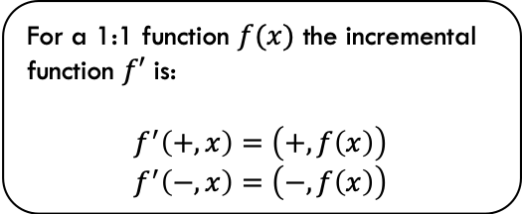
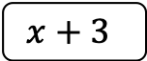
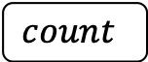
Incremental ST-UDF and UDA
sign | x
+ | 1
- | 1
sign | x
+ | 4
- | 4
For a 1:1 function $f(x)$ the incremental function $f′$ is:
$$f^{′}\left(+, x\right)=\left(+, f\left(x\right)\right)$$
$$f^{′}\left(−, x\right)=\left(−, f\left(x\right)\right)$$
ST-UDF
$$x+3$$
Revoke same result on delete
sign | x
+ | 4
- | 4
sign | x
+ | 1
UDA
$$count$$
sign | x
- | 1

Slide 30
Simple materialization
uid | Category | Timestamp
1 | start | 1
1 | other | 5
1 | end | 10
1 | other | 3
Base Table
Update Path (Insert)
sign | uid | Category | Timestamp
+ | 1 | other | 3
UDF
INSERT (1, other, 3)
INTO ‘Base Table’;
sign | uid | Click Distance
- | 1 | 2
+ | 1 | 3
uid | Click Distance
1 | 3

Slide 31
Noria Execution Model
uid | Category | Timestamp
1 | start | 1
1 | other | 5
1 | end | 10
1 | other | 3
Base Table
Update Path (Delete)
sign | uid | Category | Timestamp
- | 1 | other | 5
UDF
DELETE (1, other, 3)
FROM ‘Base Table’;
sign | uid | Click Distance
- | 1 | 3
+ | 1 | 2
uid | Click Distance
1 | 2

Slide 32
Noria Execution Model
uid | Category | Timestamp
1 | start | 1
1 | other | 5
1 | end | 10
1 | other | 3
Base Table
On-line inserts
On-line deletes
Order is random
sign | uid | Category | Timestamp
- | 1 | other | 5
UDF
sign | uid | Click Distance
- | 1 | 3
+ | 1 | 2
Commutative
Incremental
Reversible
Operations
uid | Click Distance
1 | 2

Slide 33
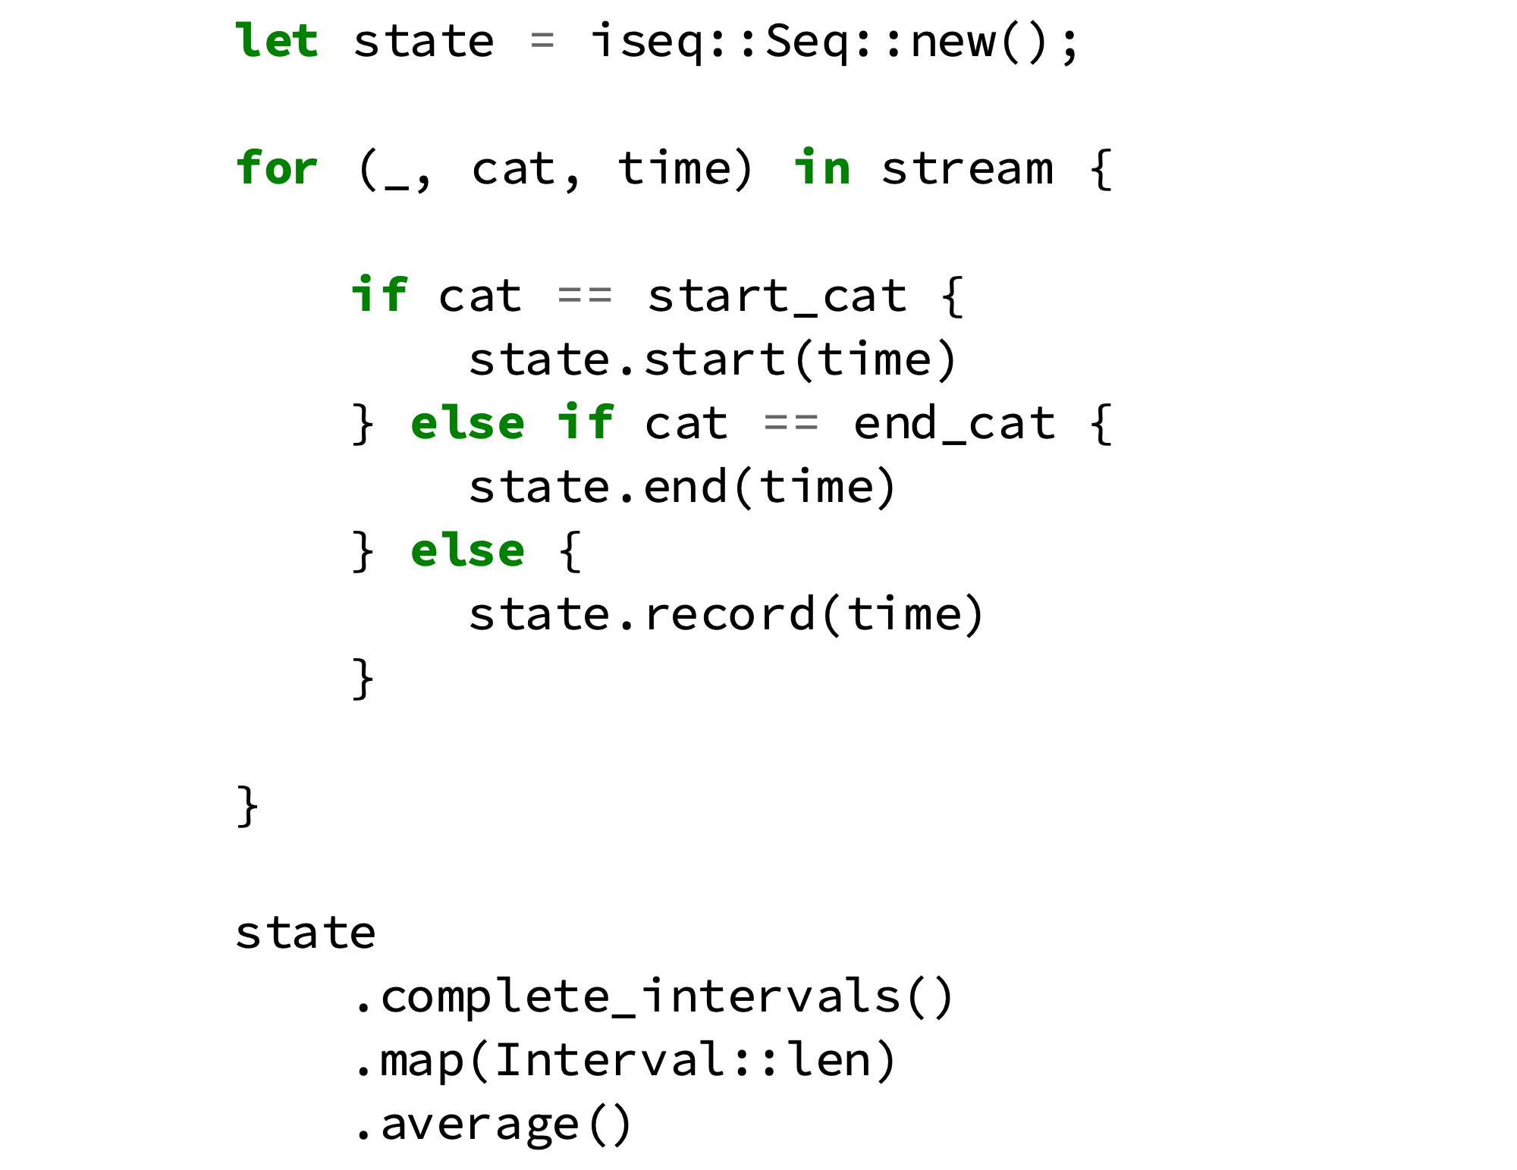
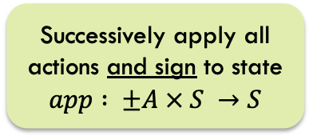
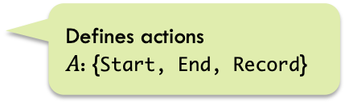
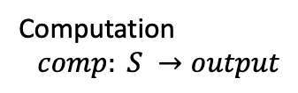

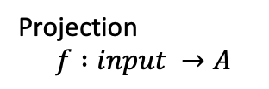
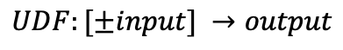
UDF State Design
State $S$
Defines actions
$A$: {Start, End, Record}
Projection
$$f :input →A$$
Affected by sign
Not affected by sign
Successively apply all actions and sign to state
$$app : ±A × S →S$$
Computation
$$comp: S →output$$
$$UDF:[±input] →output$$

Slide 34
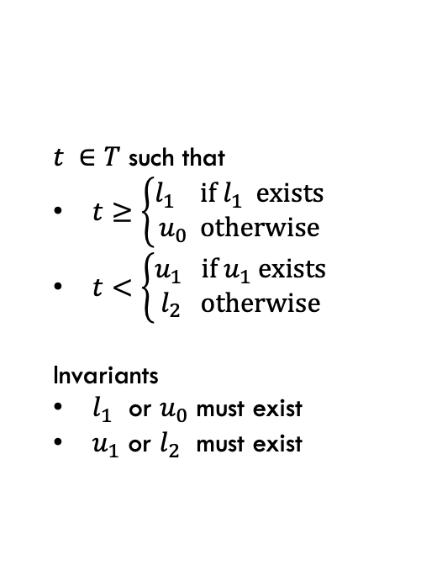
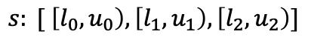
Interval Sequence as State
Base Table
uid | Category | Timestamp
1 | start | 1
1 | other | 5
1 | end | 10
1 | other | 3
$$s: [ \left[l_{0},u_{0}\right), \left[l_{1},u_{1}\right), \left[l_{2},u_{2}\right)]$$
$t ∈T$ such that
$t≥\left\{\begin{aligned}l_{1} \text{if} l_{1} \text{exists} \\ u_{0} \text{otherwise}\end{aligned}\right.$
$t<\left\{\begin{aligned}u_{1} \text{if} u_{1} \text{exists} \\ l_{2} \text{otherwise}\end{aligned}\right.$
Invariants
$l_{1}$ or $u_{0}$ must exist
$u_{1}$ or $l_{2}$ must exist
UDF
[[5,3,10].length()].average() == 3
uid | Click Distance
1 | 3
Merge intervals to maintain

Slide 35
Conclusions
Must be
Reversible
Commutative
Integrate into Partial State
Ohua Compiled UDF
Query Elements in the UDF
UDF State Design
Pure Ohua Query

Slide 36
Conclusions
Integrate into Partial State
Ohua Compiled UDF
Query Elements in the UDF
UDF State Design
Pure Ohua Query
To Support
Eviction
Lookups

Slide 37
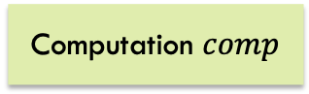
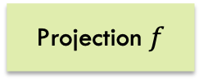
Manual Implementation
UDF
noria::dataflow::state
noria::dataflow::ops
Computation $comp$
Iteration
Projection $f$
State
Implementation
Operator
Implementation
State Integration
Operator Integration

Slide 38
Manual Implementation
UDF
>30 files touched¹
>3000 lines written¹
3 new mayor data structures
noria::dataflow::state
noria::dataflow::ops
Computation $comp$
Iteration
Projection $f$
State
Implementation
Operator
Implementation
State Integration
What. A. Mess.
Operator Integration
For whole implementation including intermediate prototypes and test code. Approximately 50% used exclusively for UDF.

Slide 39


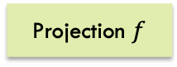
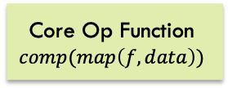
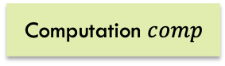
Operator Compilation
UDF Source Code
Code Splitting
Code Recombine
Noria Backend
& Code Gen
Stateful Iteration
Projection $f$
Core Op Function
$$comp(map\left(f,data\right))$$
Operator Integration
Noria Flow API
Computation $comp$
State Integration
state.rs
State
Implementation

Slide 40
Operator Compilation
UDF Source Code
Code Splitting
Code Recombine
Noria Backend
& Code Gen
Stateful Iteration
UDF code in one place
& platform unspecific
Projection $f$
Core Op Function
$$comp(map\left(f,data\right))$$
Operator Integration
Noria Flow API
Computation $comp$
State Integration
state.rs
State
Implementation

Slide 41
Conclusions
Abstraction
Conciseness
Code Locality
Integrate into Partial State
Ohua Compiled UDF
Query Elements in the UDF
UDF State Design
Pure Ohua Query

Slide 42
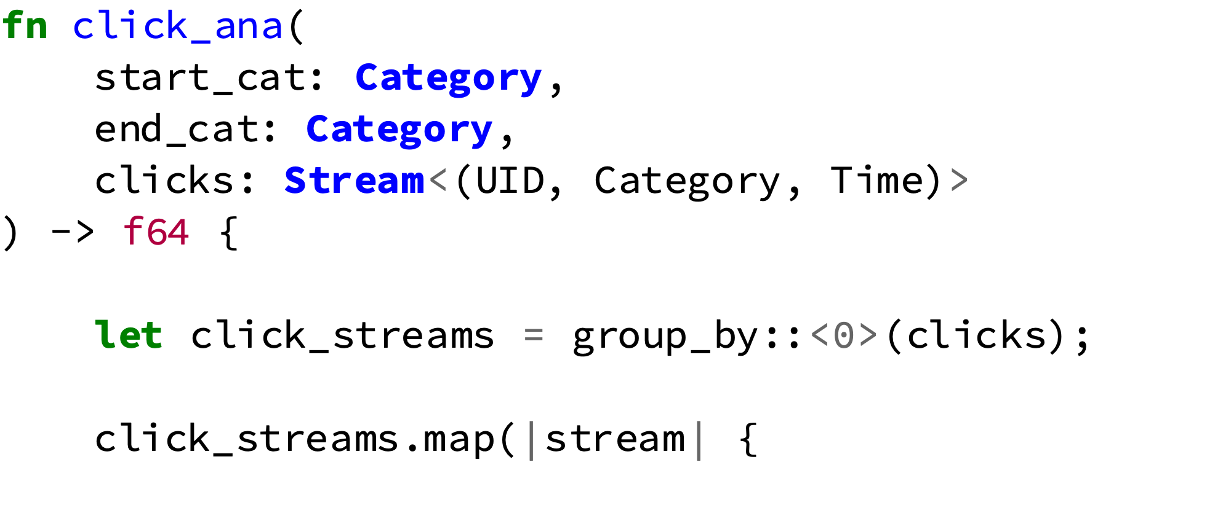
UDF Compilation
UDF Source Coce
Code Splitting
Noria Backend
Signature
Query Integration
Grouping
Noria IR Graph
...
Operator Code
Operator

Slide 43
UDF Compilation
UDF Source Coce
Code Splitting
Noria Backend
SQL-like operations
expressible in Ohua
Signature
Query Integration
Grouping
Noria IR Graph
...
Operator Code
Operator
No SQL necessary

Slide 44
Conclusions
Integrate into Partial State
Ohua Compiled UDF
Query Elements in the UDF
UDF State Design
Pure Ohua Query
Incremental
Reusable
Code Locality

Slide 45
Conclusions
Intuitive
Flexible
Composable
Fast
Must be
Reversible
Commutative
Abstraction
Conciseness
Code Locality
Integrate into Partial State
Ohua Compiled UDF
Query Elements in the UDF
UDF State Design
Pure Ohua Query
To Support
Eviction
Lookups
Incremental
Reusable
Code Locality

Slide 46
Conclusions
Must be
Reversible
Commutative
To Support
Eviction
Lookups
Abstraction
Conciseness
Code Locality
Incremental
Reusable
Code Locality
Integrate into Partial State
Ohua Compiled UDF
Query Elements in the UDF
UDF State Design
Pure Ohua Query
Intuitive
Flexible
Composable
Fast
Additional State Patterns
State builder Toolkit
More Query Elements in Ohua
Multi-State UDF’s
Non-SQL Datatypes

